Slide 1
Data Science Final Project
Is the a connection between reviews to sold units and can we predict the amount of sold units based on history data?
First name last name
First name last name
First name last name

Slide 2
Data Acquistion
Scrap product’s records using Selenium.
Pre-Process (Remove null values and sort by sold)
Carried out by the use of Python libraries.
Stored the data in lists and created the dataframes on the base of the lists.

Slide 3
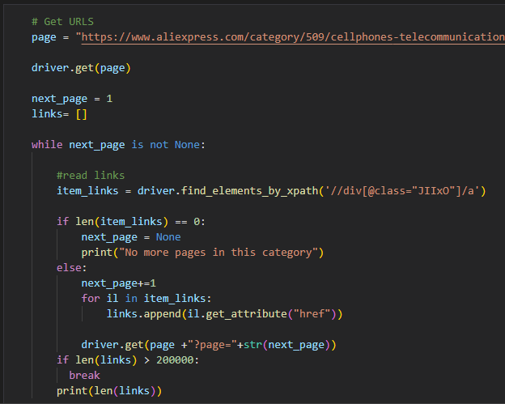
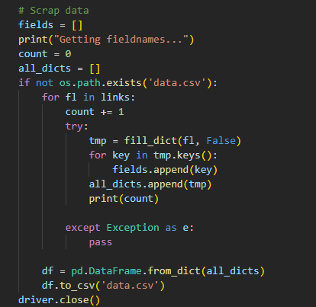
Crawling Match Logs of Players
Get URLs of Products
Scrap Product’s Records

Slide 4
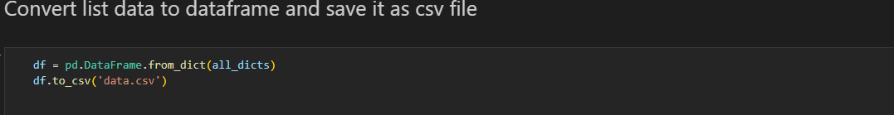
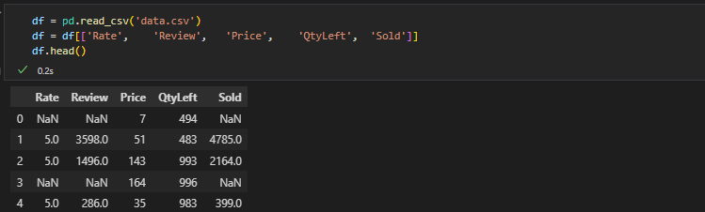
Convert to DataFrame

Slide 5
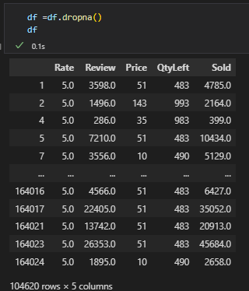
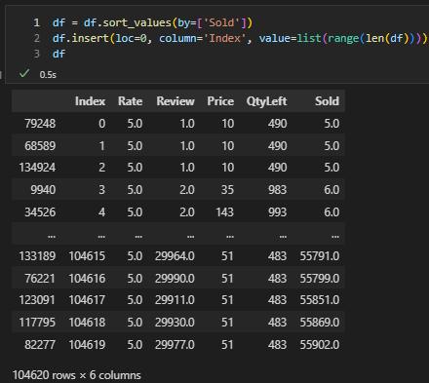
Data Pre-Processing
Check null values and remvoe them
Sort data buy sold category

Slide 6
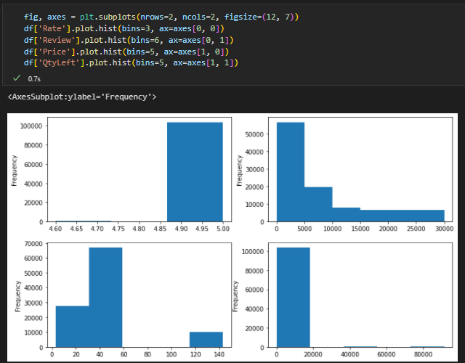
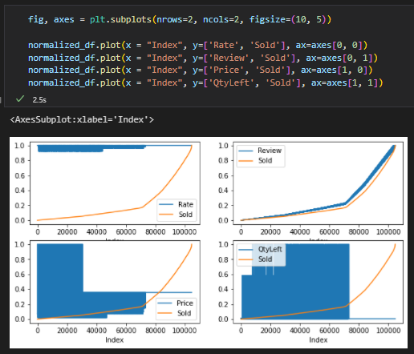
EDA(Exploratory Data Analysis)
Histogram of Categories.
Plot of Normalized Data

Slide 7
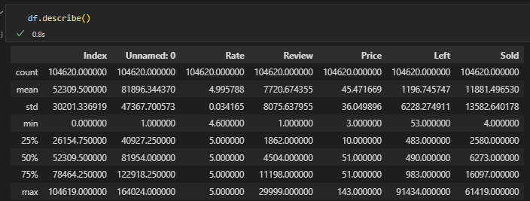
Statistical Analysis

Slide 8
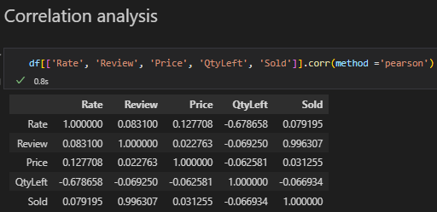
Correlation Analysis
From the above graph and correlation coefficients matrix, we can see that “review” have high absolute coefficient with “sold”.

Slide 9
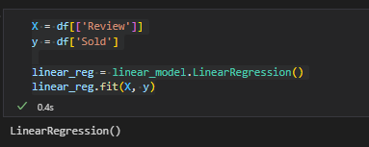
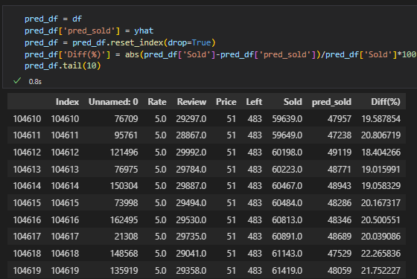
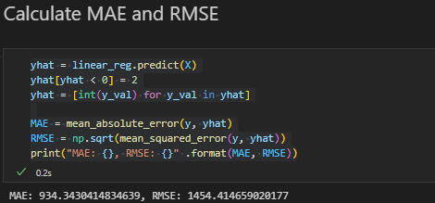
Build Linear Regression Model

Slide 10
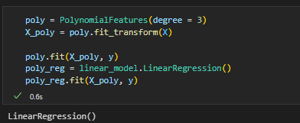
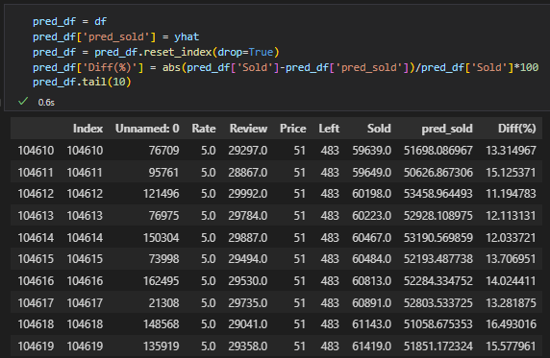
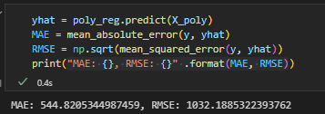
Build Polynomial Regression Model

Slide 11
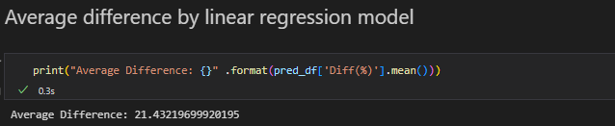
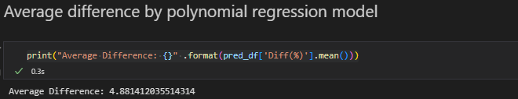
Compare Average Difference(%)

Slide 12
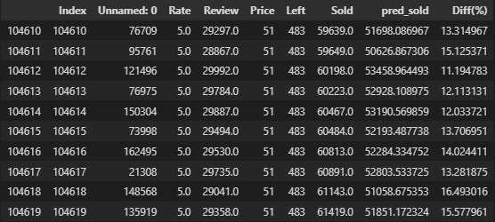
Research Question
Can we predict the sold units using reviews data?
Yes, we can predict by using the polynomial regression model which build in above.

Slide 13
Summary
We have successfully answered the research question by scrapping the items data from AliExpress using Selenium, cleaning it, exploring it and finally using polynomial regression model to predict the amount of sold items based on reviews. To predict the sold variable, We have used two models: Linear Regression and Polynomial Regression. Polynomial regression model gives lower MAE and RMSE values which means lower error and average difference between real value and predicted value. The average difference of linear regression model is over 20% and the average difference of polynomial regression model is less than 5%.

